Slide 1



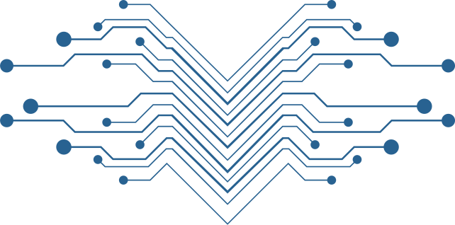
ACLC COLLEGE OF TACLOBAN
REAL STREET TACLOBAN CITY, 6500
BRANCHING STRATEGIES IN GIT
LEX KRISTOFFER P. GARADO
LOURENCE BESA
JOHN CARLO F. ROTILLES
INSTRUCTOR

Slide 2
ACLC COLLEGE OF TACLOBAN
REAL STREET TACLOBAN CITY, 6500
Key Terms
Git Branch: A parallel version of the code within a Git repository, allowing for separate development and experimentation.
Main Branch (formerly Master Branch): The primary branch of a Git repository where the production-ready code resides.
Feature Branch: A branch created to work on a specific feature or task isolated from the main branch.
Merge: The process of combining changes from one branch into another.
Pull Request (PR): A request made by a developer to merge their changes into another branch, often used for code review.

Slide 3
ACLC COLLEGE OF TACLOBAN
REAL STREET TACLOBAN CITY, 6500
What are Branches?
Branches are independent lines of work, stemming from the original codebase. Developers create separate branches for independently working on features so that changes from other developers don't interfere with an individual's line of work. Developers can easily pull changes from different branches and also merge their code with the main branch. This allows easier collaboration for developers working on one codebase.

Slide 4
ACLC COLLEGE OF TACLOBAN
REAL STREET TACLOBAN CITY, 6500
What is a Branching Strategy?
A branching strategy is a strategy that software development teams adopt for writing, merging and deploying code with the help of a version control system like Git. It lays down a set of rules that aid the developers on how to go about the development process and interact with a shared codebase. Strategies like these are essential as they help in keeping project repositories organized, error free and avoid the dreaded merge conflicts when multiple developers simultaneously push and pull code from the same repository.

Slide 5
ACLC COLLEGE OF TACLOBAN
REAL STREET TACLOBAN CITY, 6500
Why Branch?
The Branching strategies provides following features:
Parallel development
Enhanced productivity due to efficient collaboration
Organized and structured feature releases
Clear path for software development process
Bug-free environment without disrupting development workflow

Slide 6
ACLC COLLEGE OF TACLOBAN
REAL STREET TACLOBAN CITY, 6500
Gitflow
GitFlow enables parallel development, where developers can work separately on feature branches, where a feature branch is created from a master branch. After completion of changes, the feature branch is merged with the master branch.
Types of Branches that may be present in GitFlow:
Master - Used for product release
Develop - Used for ongoing development
Feature Branching - branches off the develop branch to develop new features.
Release - Assist in preparing a new production release and bug fixing, typically branched from the develop branch, and necessitating merges back into both develop and master branches.
Hotfix - Hotfix branches aid in addressing discovered bugs swiftly. Created from master branch

Slide 7
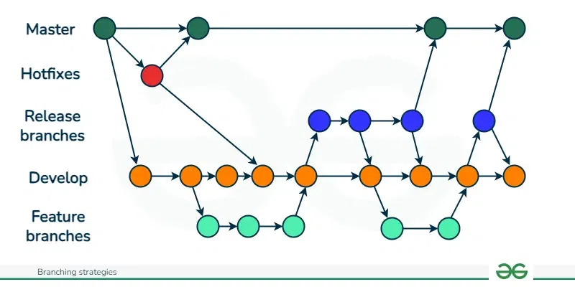
ACLC COLLEGE OF TACLOBAN
REAL STREET TACLOBAN CITY, 6500
Gitflow

Slide 8
ACLC COLLEGE OF TACLOBAN
REAL STREET TACLOBAN CITY, 6500
Github Flow
GitHub flow is a simpler alternative to GitFlow, idea for smaller teams. GitHub flow only has feature branches that stem directly from the master branch and are merged back to master after completing changes. They don't have release branches. The fundamental concept of this model revolves around maintaining the master code in a consistently deployable condition, thereby enabling the seamless implementation of faster release cycles, continuous integration and continuous delivery workflows.
The types of branches that can be present in GitFlow are:
Master - The GitHub Flow workflow initiates with the master branch, housing the most recent stable code prepared for release.
Feature - Developers initiate feature branches from the main branch to implement new features or address bugs. Upon completion, the feature branch is merged back into the main branch.

Slide 9
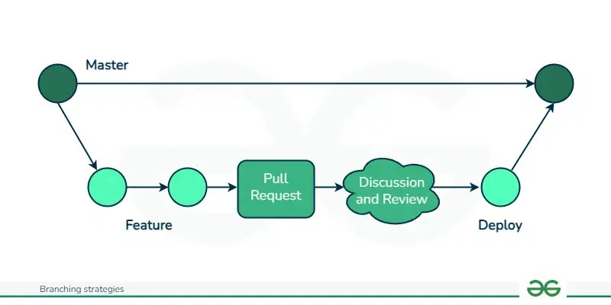
ACLC COLLEGE OF TACLOBAN
REAL STREET TACLOBAN CITY, 6500
Github Flow

Slide 10
ACLC COLLEGE OF TACLOBAN
REAL STREET TACLOBAN CITY, 6500
GitLab Flow
GitLab flow is also an alternative to GitFlow, designed to be more robust and scalable than GitHub Flow. Designed for teams using GitLab, a web-based Git repository manager, this approach streamlines development by concentrating on a solitary, protected branch, usually the master branch. Continuous integration and automated testing form the core elements of GitLab Flow, guaranteeing the stability of the master branch.
Master: Main production branch housing stable release ready code.
Develop: Contains new features and bug fixes.
Feature: Developers initiate feature branches from the develop branch to implement new features or address bugs. After, itegrate into develop branch
Release: Prior to a new release, a release branch is branched off from the develop branch.

Slide 11
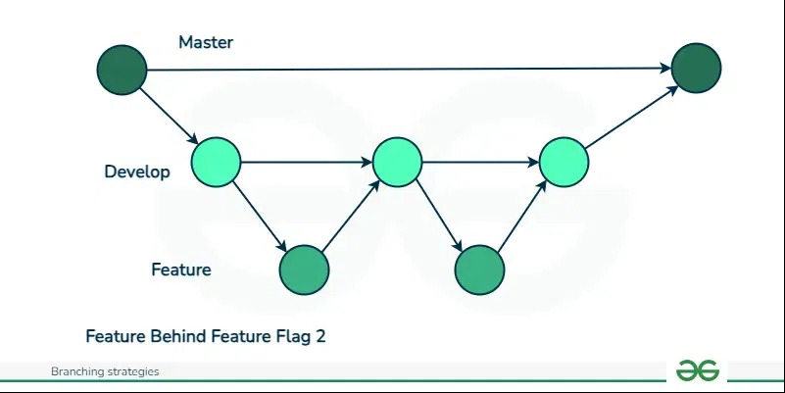
ACLC COLLEGE OF TACLOBAN
REAL STREET TACLOBAN CITY, 6500
GitLab Flow

Slide 12
ACLC COLLEGE OF TACLOBAN
REAL STREET TACLOBAN CITY, 6500
Trunk Based Development
It is a branching strategy where developers work on a single "trunk" branch, mostly the master branch and use feature flags to isolate features until they are ready for release. This main branch should be ready for release any time. No additional branches are created. The main idea behind this strategy is to make smaller changes more frequently to avoid merge conflicts and the goal is to limit long-lasting branches. This strategy enables continuous integration and delivery, making it an attractive choice for teams aiming to release updates swiftly and frequently. It is particularly well-suited for smaller projects or teams seeking a streamlined workflow.

Slide 13
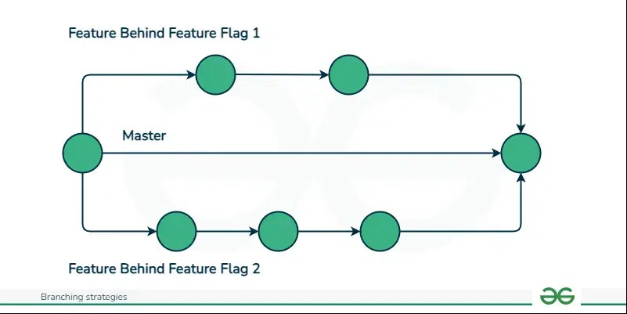
ACLC COLLEGE OF TACLOBAN
REAL STREET TACLOBAN CITY, 6500
Trunk Based Development

Slide 14
ACLC COLLEGE OF TACLOBAN
REAL STREET TACLOBAN CITY, 6500
Trunk Based Development
Product Type | Team Size | Applicable Strategy
Continuous Deployment and Releaseelease | Small | GitHub Flow and TBD
Scheduled and Periodic Version Release | Medium | GitFlow and GitLab Flow
Continuous deployment for quality-focused products | Medium | GitLab Flow
Products with long maintenance cycles | Large | GitFlow

